Slide 1
Welcome to the Year 4 class meeting
2026

Slide 2
Our Braywood and Year 4 class rules are: ​
Ready
Respectful
Safe​
Notes:
Develop a love of learning​, Become increasingly independent​, Be kind and respectful to others​, Feel happy, safe and confident​, Feel that they belong​, Be proud of their achievements.

Slide 3
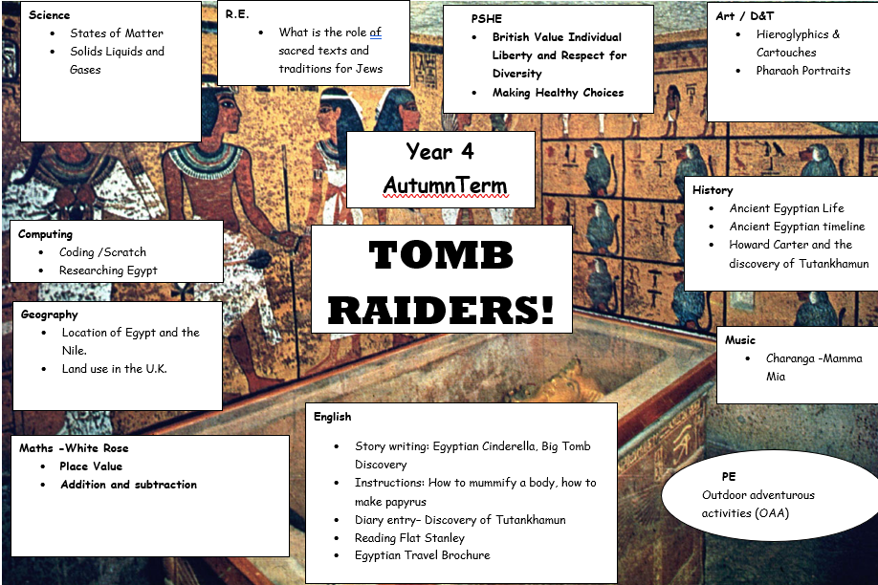

Slide 4


Literacy- Comparing texts

Slide 5
Literacy
Compare different cultural versions of a traditional story
Predict what might happen
To use comparative and coordinating conjunctions
To use noun phrases
To use a thesaurus and or word bank to improve writing
To infer how a character feels
To consider different points of view
To debate an argument
To innovate - plan a story
To self edit and uplevel their own sentences

Slide 6
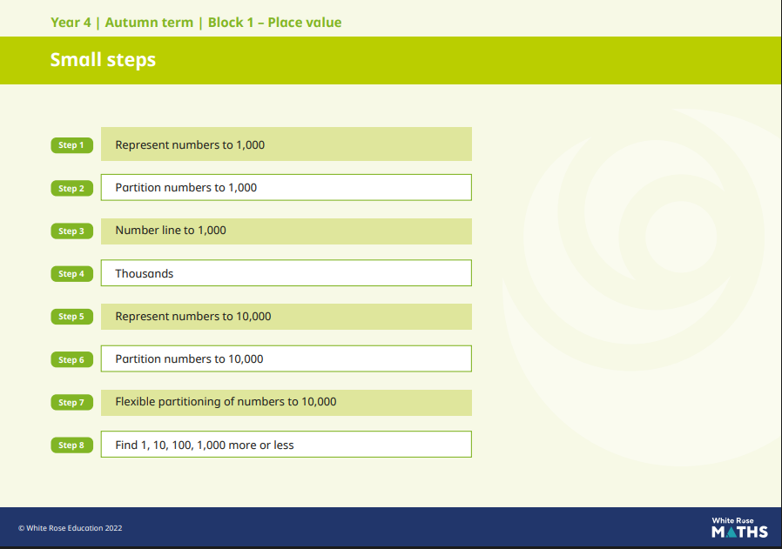
Year 4 White Rose Maths

Slide 7
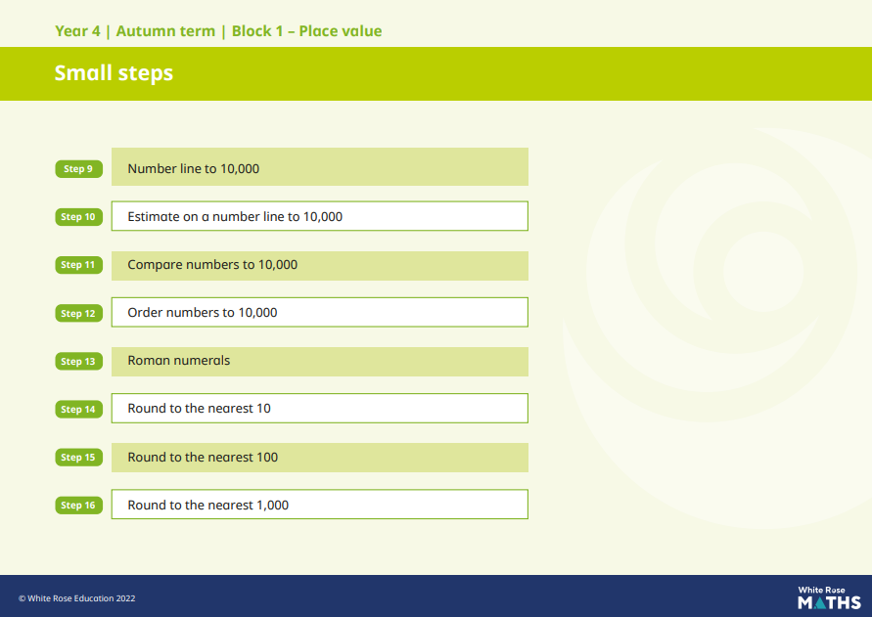

Slide 8
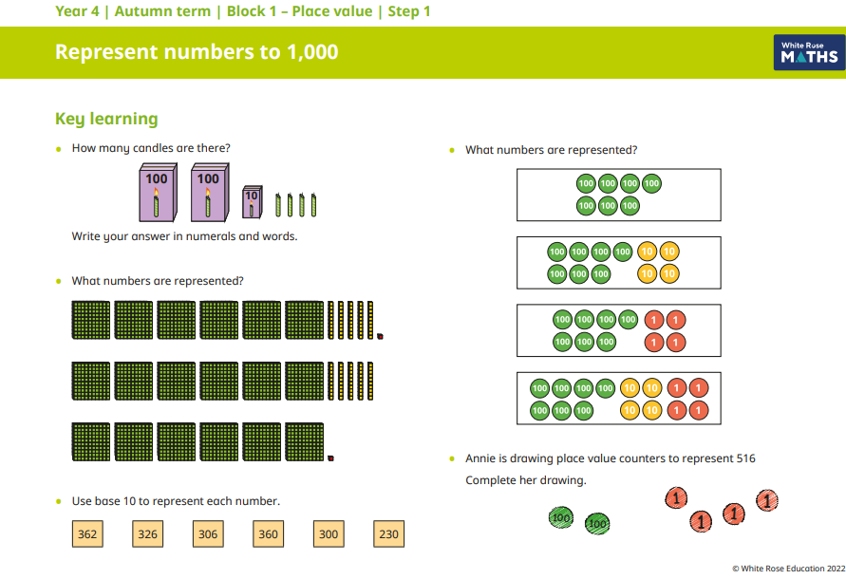

Slide 9
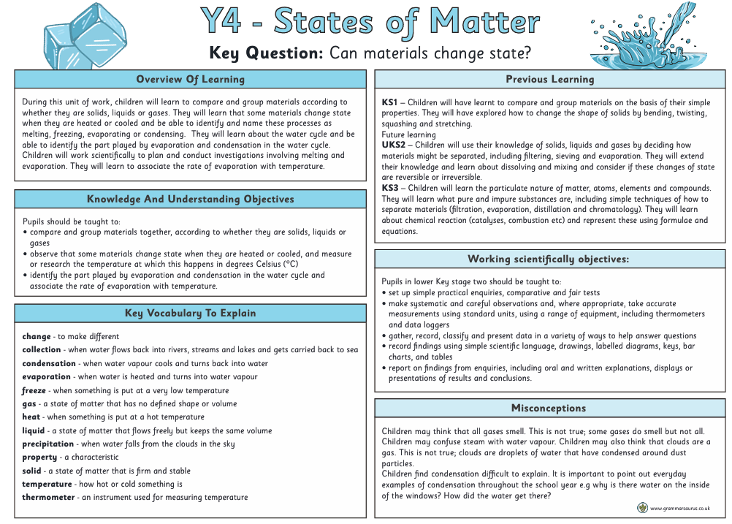
Science

Slide 10
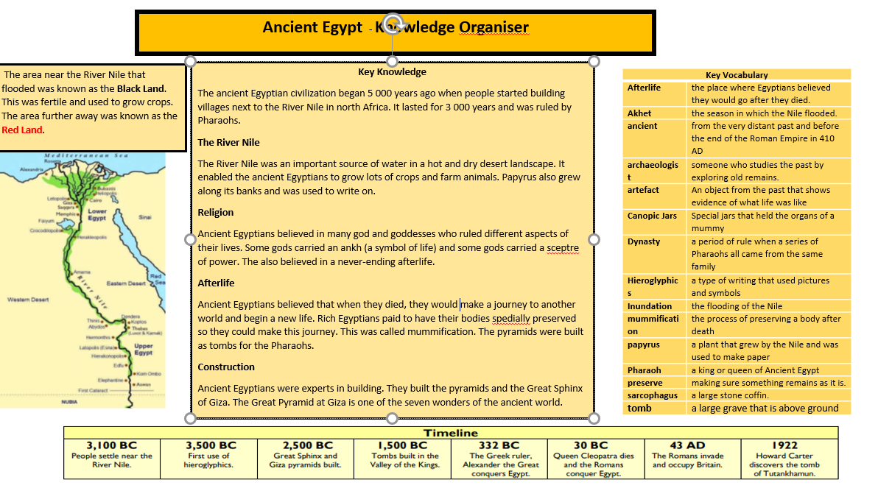
History

Slide 11
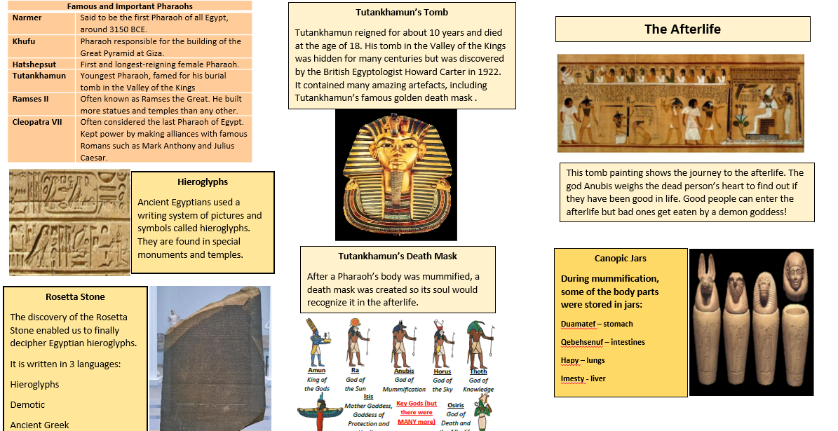

Slide 12
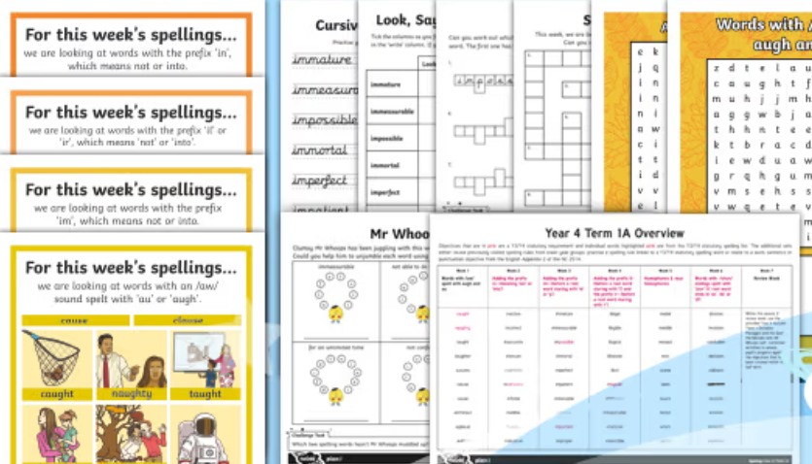
Spelling Homework
In Year 4 your child will receive this terms spellings weekly via your E schools platform (weekly email). These spellings are taken from the Year 4 expected word list.
This term the spellings are 1A.

Slide 13
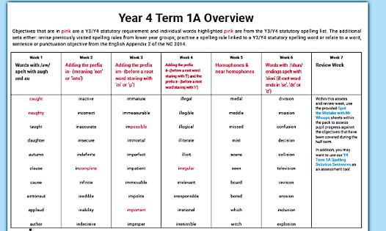
Spellings

Slide 14
Reading Homework
Please read with your child each night for 10-15 minutes.
This will enable your child to develop an understanding of the texts they are reading.
How to achieve this:
Asking questions to develop reading for understanding.
E.G. Retrieval of key Knowledge:
What happened after….?
Who was the main character…..?
Can you name him/her …..?
Notes:
Read for 10-15 minutes encouraging your child to develop an understanding of the texts they are reading.
Ask questions, for example: What happened after…? Who was the main character…? Can you name him/her…?
Comprehension: Retell me the story in your own words. Give me a definition for… using a reference from the text.
Prediction: look at the front page of the book and ask your child to predict what the book will be about. After reading ask if their prediction was correct.

Slide 15
Reading for understanding.
Comprehension
Explain in your own words.
What might happen next?
Give me an example.
Compare…….and………..
Give a definition for…….

Slide 16
Reading for understanding.
Application
What is the purpose of……..?
Why are…………needed?
Could this have happened in ……?
Analysis
What was the turning point?
If………..happened how could the ending be different?

Slide 17
Reading for understanding.
Synthesis
What is a possible solution to……..?
Can you design a ……….to………?
Evaluation
Defend your position about………?
Do you think………..is a good or bad thing? Explain.
What changes would you make and why?

Slide 18
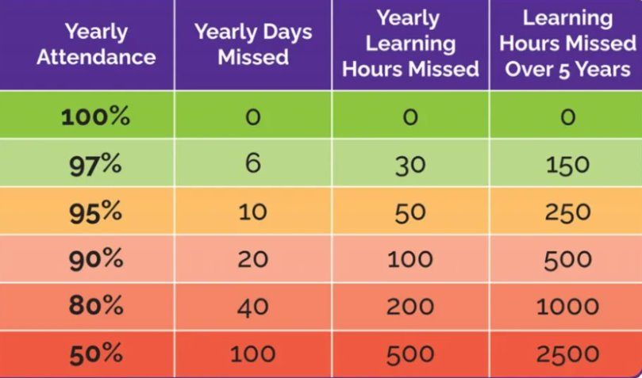
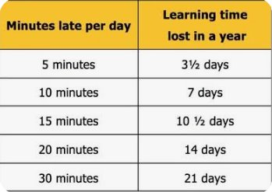
Attendance and Learning

Slide 19

Many thanks, Mrs Kilner & Ms Hackett
From Little Acorns, Mighty Oak trees grow, watered and nurtured by God’s love .

