Slide 1
Welcome to Year 3
Oak Class
Ready, Respectful, Safe.
"We aspire for all our children to become confident, emotionally resilient and compassionate individuals who achieve personal excellence through strength of character and a love of learning"

Slide 2
What’s new?
Key stage 2
Year 3 Team: Ms Anderson and Mrs Moss (with Miss Hackett on Tuesday PM)
Greater opportunity for responsibility and leadership
Work with Year 4
French and discrete Grammar lessons rather than phonics

Slide 3
Topic
Stone Age (We Will Rock You)
Egyptians (Tomb Raiders)
Rainforests (Canopy Capers)

Slide 4
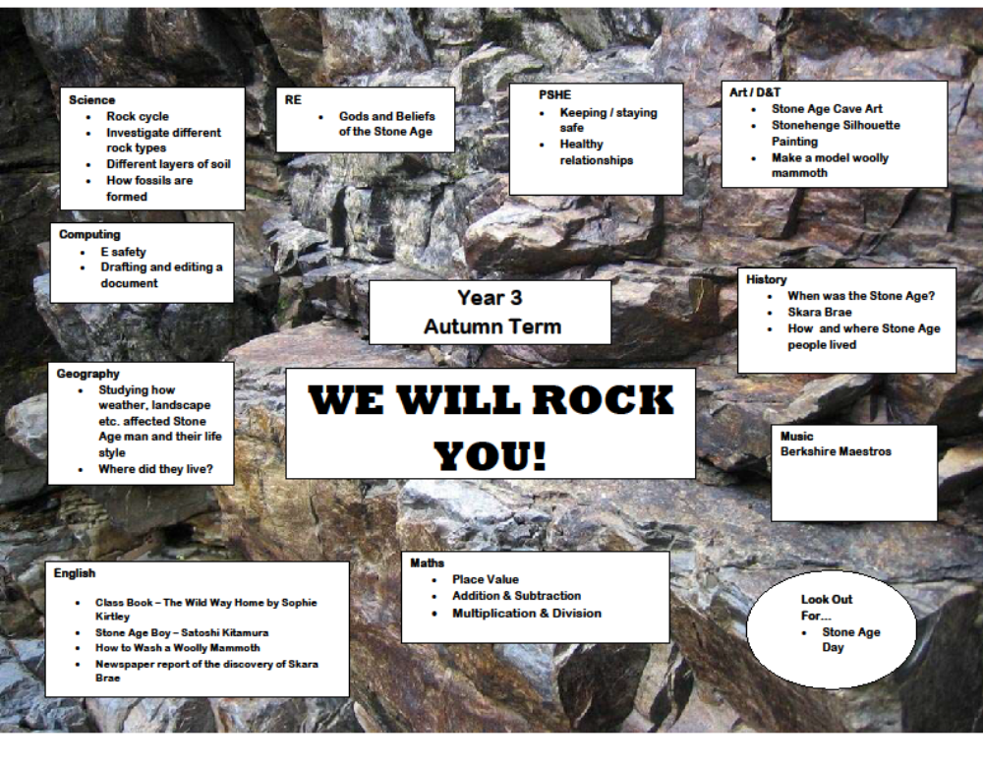

Slide 5
Reading
Everyday at home and school
Individual and group reading at school
Increasing emphasis on comprehension
Children choose their own books
Children must read the majority of books within that level

Slide 6
Writing
Focus on handwriting, in readiness for obtaining a pen license.
Cursive style, letter starts on the line
Practice handwriting with discrete handwriting lessons.
Letters to be written between the lines of 4mm

Slide 7
Spellings
Use – look, say, cover, write, check
Look at the shape of the word
Sound out/spell out loud/use syllables
Write without looking
Practice with sentences- context

Slide 8
Times Tables
All children start on 2X tables
Tables quizzes are on Fridays
The order of learning is 2X, 5X, 10X, 3X, 4X, 8X, 6X, 9X, 11X, 12X, 7X.
Children are encouraged to use TTRS, which will help them improve their speed of recall, and their dexterity with a keyboard. These logins will be sent out this Friday.

Slide 9
PE
PE days will differ from term to term
Children should attend school on their PE day in their PE kit
This term until Christmas it is on Wednesdays.
Swimming
Swimming takes place every other year for KS2, and so will take place this academic year in Term 3. This is a compulsory part of the national curriculum and all children must take part.

Slide 10
Pride and Presentation
Presentation of work is important
Headings to be underlined with ruler
Work to be completed within the timescale
Read through and edit work
Fix-it time. Children should comment on marking and correct any mistakes

Slide 11
Conflict at school
We may not have been told about issues, or have been given all the details
Please inform school staff to resolve

Slide 12

Have a great day!

