Slide 1
Welcome to the Year 2 class meeting
2026

Slide 2
Our Braywood and Year 2 class rules are: ​
Ready
Respectful
Safe​
Notes:
Develop a love of learning​, Become increasingly independent​, Be kind and respectful to others​, Feel happy, safe and confident​, Feel that they belong​, Be proud of their achievements.

Slide 3
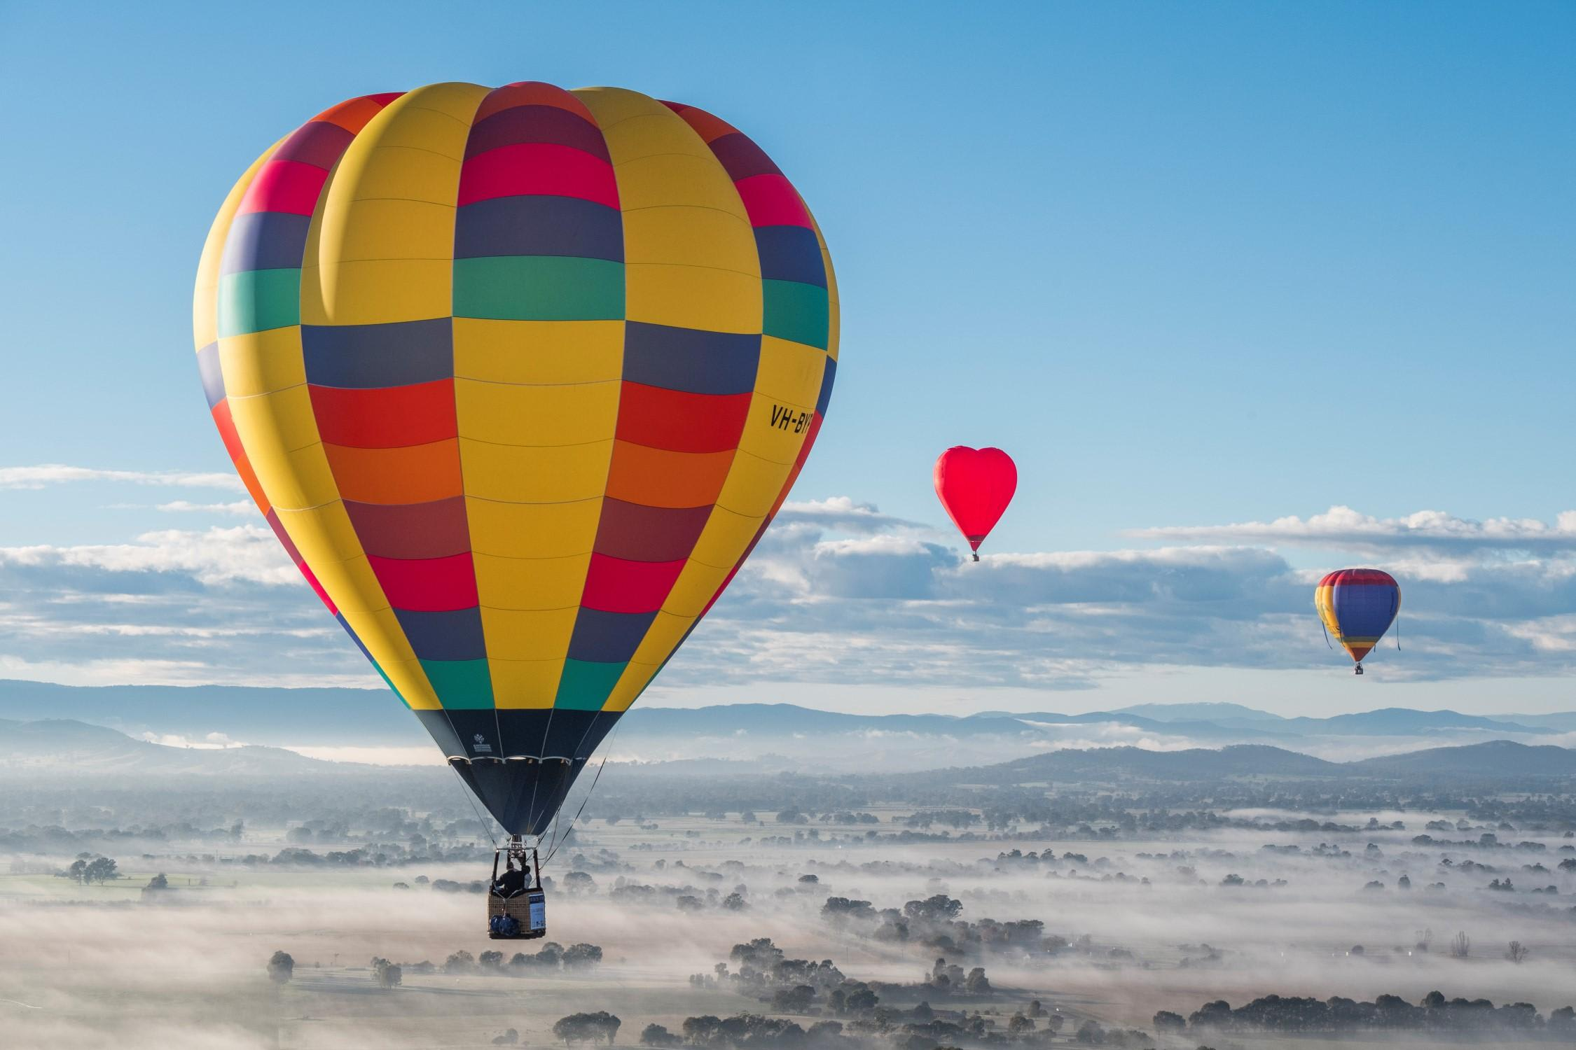
Curriculum overview Autumn term​
Maths
Place value
Addition and subtraction
Addition and subtraction shapes
English
Whatever next
Man on the Moon
Owl who was afraid of the dark
Moon landing
Narrative
Diary
Jounalistic Writing
Science
Seasonal changes 1 – Materials
Seasonal changes 2 – Materials
Come Fly With Me
Year 2
RE
What might a Jewish way of life look like?
How and where do different Christians worship and celebrate?
Topic/ History
The first flight
Who Wright Brothers
Why were they successful?
Art and DT
Birds of Paradise
Kite making
Cooking
Computing
Computing systems
Using a computer
PSHE
My healthy self
How to look after our bodies

Slide 4
Literacy
I can think, say and hold a sentence in my head
I can write my ideas into simple sentences.
Joining two simple sentences using the conjunction “and”.
Punctuating sentences with a capital letter and full stop.
Using capital letter for people and places (Proper nouns).

Slide 5
Year 2 White Rose Maths
Place value
Addition and subtraction
Addition and subtraction shape

Slide 6
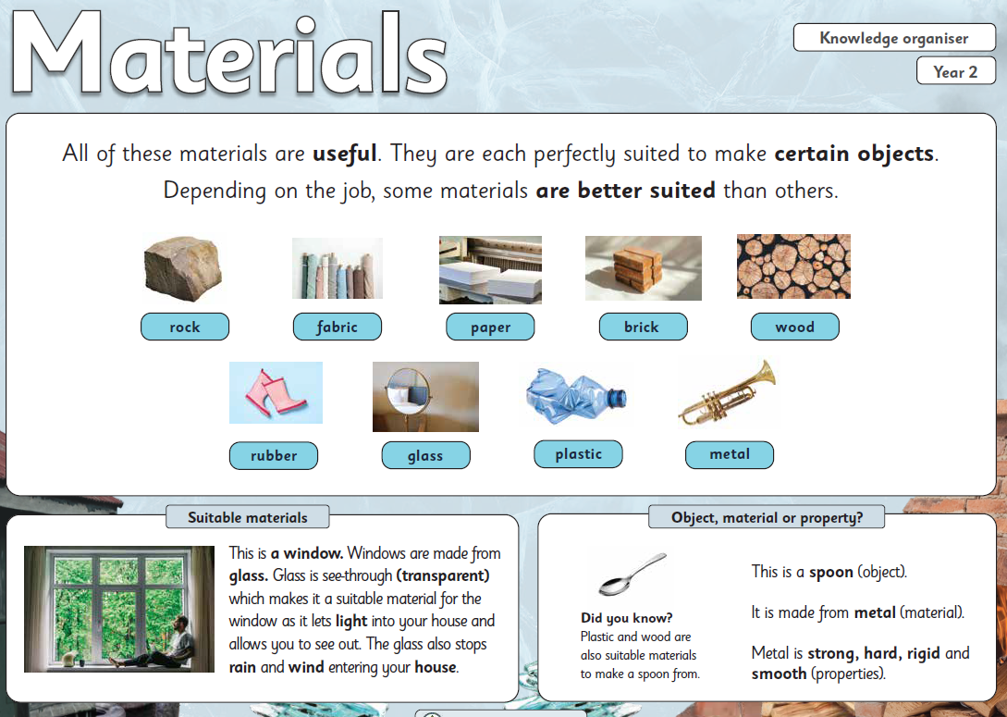
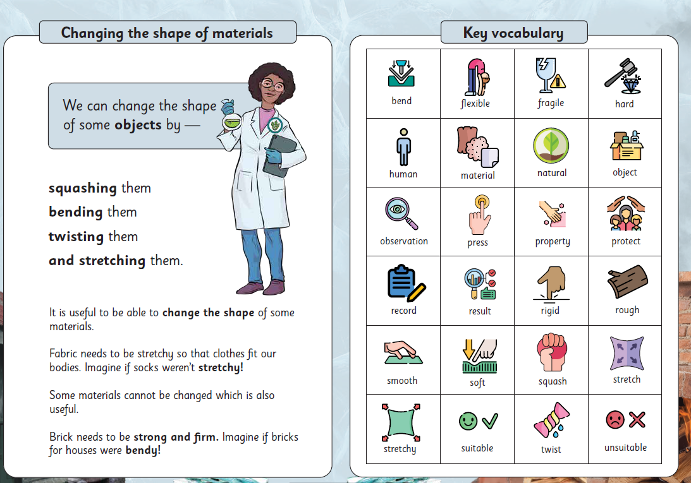
Science

Slide 7
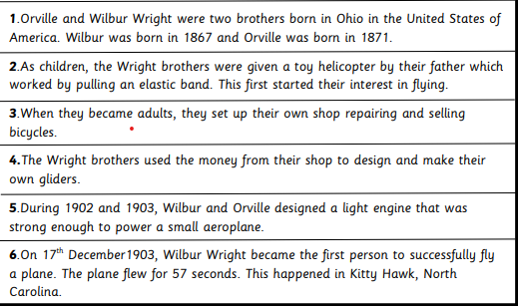
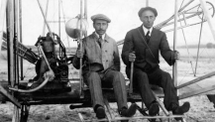





Topic/ History
The Wright Brothers
Vocabulary
aviation | The act, practice, or science of flying
engineer | A person who solves problems with their inventions
evidence | Something that gives proof
famous | Recognised by the public
solo | Something done by one person
glider | an aircraft that flies without an engine
invention | something created by man
Florence Nightingale was alive at the time of the First Flight
Significant developments in flight
In 1485, Leonardo da Vinci designed an ornithopter. This was a machine that would fly by flapping its wings.
In 1783, The Montgolfier brothers invented the hot air balloon.
In 1939, the first helicopter flew.
In 1961, the first manned flight into space took place

Slide 8
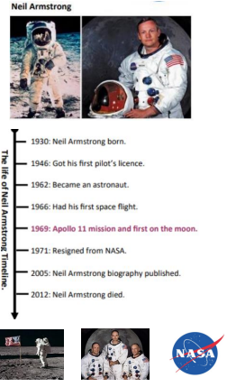
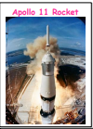

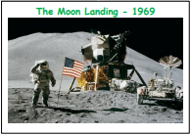
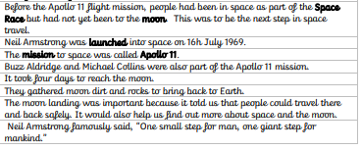
Moon Landing
Vocabulary
astronaut | A person that travels into space
Moon | A body that orbits the Earth
launch | Put into motion
Apollo 11 | The spaceflight that first landed humans on the moon
Significant event | An important thing that has happened
Solar system | Our solar system consists of the sun and the planets that orbit it.
NASA | National Aeronautics and Space Administration
Mission | An important job to be completed
Space Race | Competition between the USA and Russia to reach space
exploration | To go somewhere unfamiliar
Key Facts

Slide 9
​
PE this half term will be every Monday and led by the Windsor Sports Partnership.
Please could your child come to school in his or hers P.E. Kit with trainers. Also if your child wears earrings to school could they please be covered with tape or removed for health and safety purposes.
​

Slide 10
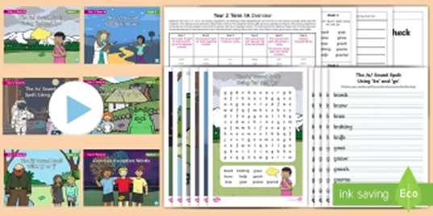
Spelling Homework
In Year 2 your child will receive this terms spellings weekly via your E schools platform (weekly email). These spellings are taken from the Year 2 expected word list.
This term the spellings are 1A.

Slide 11
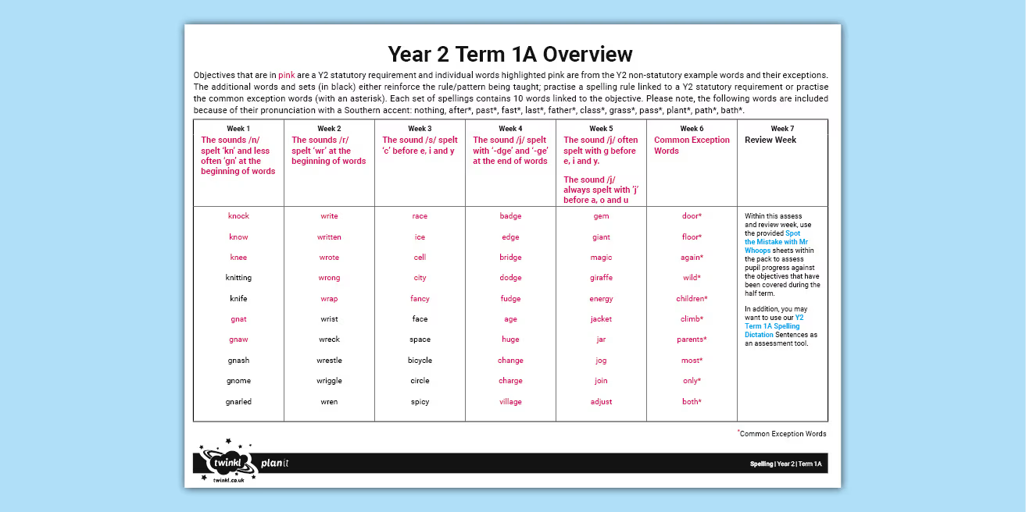
Spellings

Slide 12
Reading Homework
Please read with your child each night for 10-15 minutes.
This will enable your child to develop an understanding of the texts they are reading.
How to achieve this:
Asking questions to develop reading for understanding.
E.G. Retrieval of key Knowledge:
What happened after….?
Who was the main character…..?
Can you name him/her …..?
Notes:
Read for 10-15 minutes encouraging your child to develop an understanding of the texts they are reading.
Ask questions, for example: What happened after…? Who was the main character…? Can you name him/her…?
Comprehension: Retell me the story in your own words. Give me a definition for… using a reference from the text.
Prediction: look at the front page of the book and ask your child to predict what the book will be about. After reading ask if their prediction was correct.

Slide 13
Reading for understanding.
Comprehension
Explain in your own words.
What might happen next?
Give me an example.
Compare…….and………..
Give a definition for…….

Slide 14
Reading for understanding.
Application
What is the purpose of……..?
Why are…………needed?
Could this have happened in ……?
Analysis
What was the turning point?
If………..happened how could the ending be different?

Slide 15
Reading for understanding.
Synthesis
What is a possible solution to……..?
Can you design a ……….to………?
Evaluation
Defend your position about………?
Do you think………..is a good or bad thing? Explain.
What changes would you make and why?

Slide 16
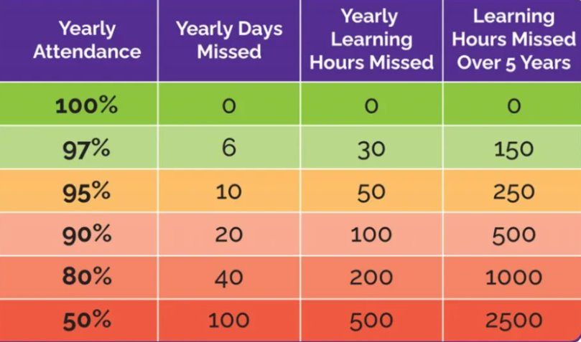
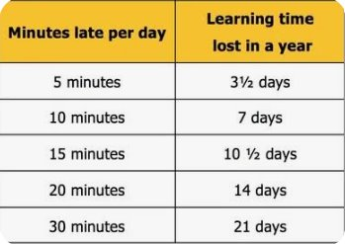
Attendance and Learning

Slide 17
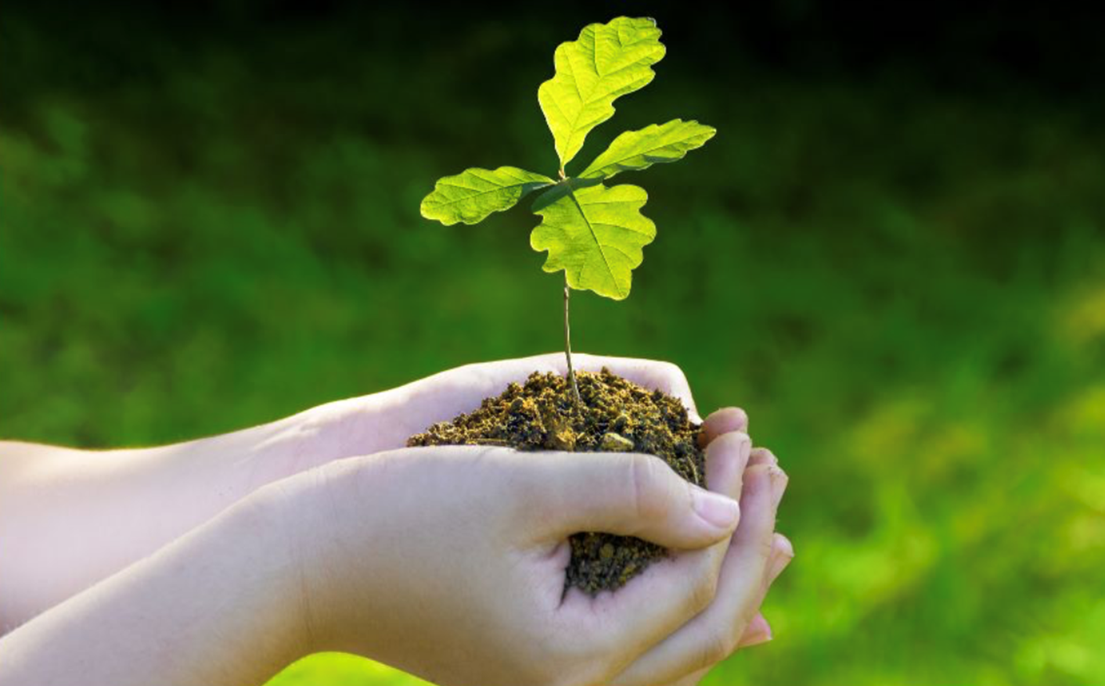
Many thanks, Mrs Rodrigues and Miss Grace
From Little Acorns, Mighty Oak trees grow, watered and nurtured by God’s love .

