Slide 1
Welcome Everyone!
Year 1 Class Meeting 2026

Slide 2
Introduction to Year 1
Mrs Madeley (Monday to Friday) Class Teacher
Mrs Reeves (Monday to Wednesday) Assistant Teacher
Miss O’Neill (Thursday and Friday) Assistant Teacher
Notes:
Welcome to Year 1!
A new year of learning, growing and becoming more independent
We are excited to get to know your children
Our classroom will be a place where every child feels safe, valued and that they belong
Teacher message:
“Thank you for joining us. We are really looking forward to working together to make Year 1 a happy, successful and memorable year for your child.”

Slide 3
Our vision
We want every child to:
Feel happy, safe and confident
Develop a love of learning
Become increasingly independent
Be kind and respectful to others
Feel that they belong
Be proud of their achievements
Notes:
Year 1 is an exciting transition from Reception into more formal learning.
Children will continue to learn through:
Practical activities
Talk and discussion
Exploration and investigation
Stories and books
Games and collaborative learning
Independent tasks
We will gradually encourage children to:
Listen for longer
Follow instructions
Complete tasks independently
Organise their belongings
Take responsibility for their learning

Slide 4
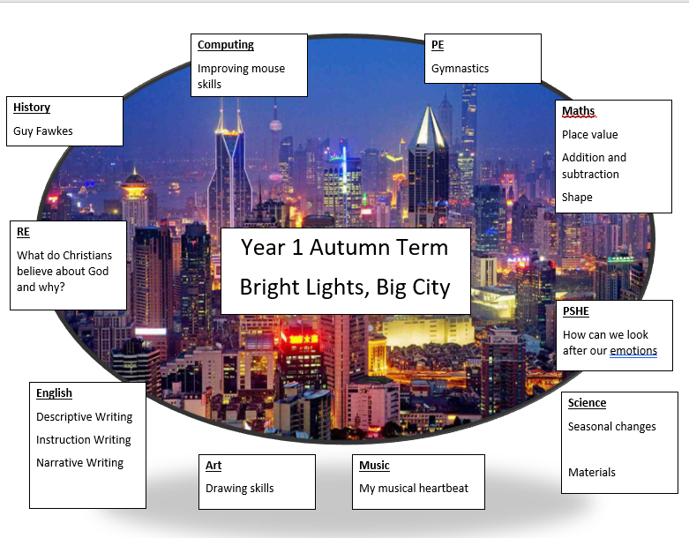
Curriculum overview Autumn term
Notes:
What will we learn

Slide 5
Our shared goal
Read together and regularly
Attendance and punctuality
Communicate
Notes:
Read regularly
Reading with your child every day, even for a short time, helps develop their vocabulary, comprehension, confidence and love of books. Please talk about the story, ask questions and encourage your child to share their ideas.
🗓️ Support good attendance and punctuality
Coming to school regularly and arriving on time helps children settle into their routines, build friendships and avoid missing important learning. Every school day matters, and being in school consistently gives children the best opportunity to make progress.
💬 Communicate with us
Please talk to us if you have any concerns, worries or changes at home that may affect your child. We are here to listen and support you. When home and school communicate openly, we can respond to your child’s needs more effectively.

Slide 6
Reading
Reading is one of the most important ways you can support your child.
Please try to:
Read with your child every day
Talk about the story and pictures
Ask questions about what they have read
Encourage your child to sound out unfamiliar words using their robot arms and blending hands
Notes:
Get a book once a week aim is to become fluent and confident and build stamina with their reading so the first day they might need to sound out and blend the word, by the end of the week aim is to be reading the book fluently – if you feel they are fluent then talk about the story ask questions find information this is will help with their comprehension and inference skills
Please not wont get a book unitll about week 3 as there is recap and retrieval and providing time for them to settle into year 1
Also sending some spellings home to practice
The "Four-Read" Strategy for Mastery
Rather than rushing through multiple books, the ELS program expects children to practice reading the same book four times across the week. Each reading focuses on developing a different layer of literacy: [1, 2]
Read 1: Decode: The child focuses on sounding out individual letters and blending them together to read the words.
Read 2: Fluency: The child re-reads the text with more automatic word recognition and fewer pauses for decoding.
Read 3: Expression: The child practices using intonation, tone, and expression to bring the story or text to life.
Read 4: Comprehension: Because the child no longer has to struggle with decoding or speed, they can focus entirely on understanding and talking about the meaning of the book. [1, 2]
By keeping the book for a full week, children shift from basic mechanical decoding to genuinely confident, expressive reading. [1]
Ofsted treats reading as the absolute "gateway to learning" and a non-negotiable foundational skill required to access the rest of the curriculum. [1, 2]
Core Principles
Reading is fundamental: Pupils who cannot read well quickly fall behind in all other subjects. [1]

Slide 7
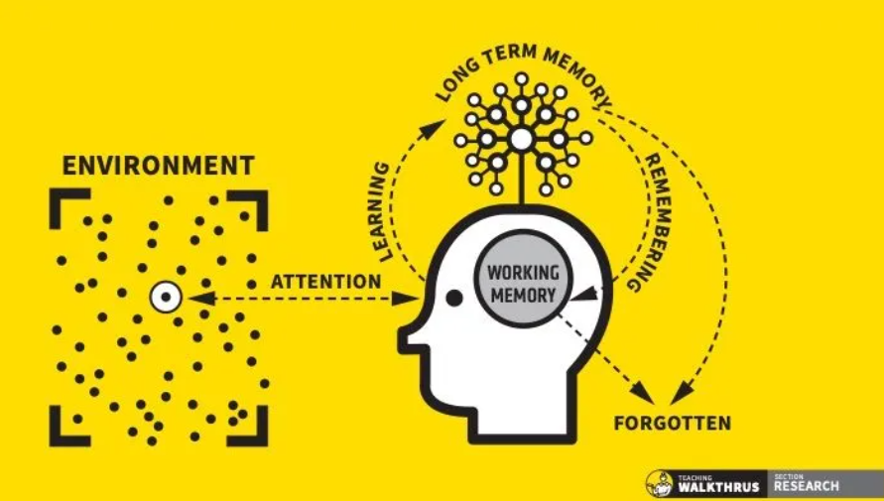
Notes:
Working memory is your brain's temporary scratchpad that holds 3 to 7 pieces of information for about 20 seconds before you either encode it into long-term memory or lose it.
What is Working Memory?
Working memory is the active mental workspace you use to think, reason, and make decisions. It lets you manipulate information right in front of you, like solving a math problem in your head or remembering a phone number just long enough to type it.
How Much Information is Stored? (Capacity)
The limit: Your working memory holds about 3 to 7 items at one time.
The Walk-Thru: From Working to Long-Term Memory
The Input (Attention):
You see or hear a new piece of information. You must pay attention to it, or it bypasses working memory entirely and is lost immediately.
The Holding Zone (Working Memory):
The information enters your temporary workspace. It sits there for up to 20 seconds, limited to that 3-to-7 item cap.
The Processing (Rehearsal and Encoding):
To save the information, you actively repeat it (maintenance rehearsal) or connect it to things you already know (elaborative rehearsal).
The Transfer (Long-Term Memory):
Because of this processing, your brain physically alters neural connections. The data moves from a temporary spark into permanent long-term memory storage, where it can sit for years.

Slide 8
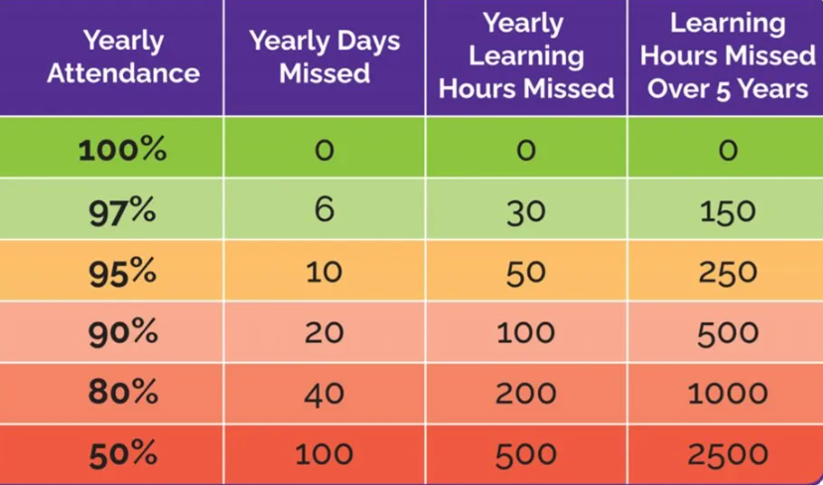
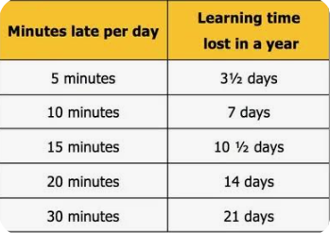
Attendance
Notes:
Communicate let me know if feeling unwell – keep an eye – make a decision

Slide 9
Other points to note.
Please let me myself or a member of the Saplings team know if there are any concerns. Email.
PE kits will be worn on the designated PE day (Monday)
Label all uniform

