Slide 1


Welcome to
Little Acorns
Foundation Stage
September 2026

Slide 2
Meet the Teachers
Class Teacher
Mrs N Teeder
Teaching Assistant
Mrs S Khan

Slide 3
School Day 8.30 – 3pm
Topic based
Teacher/ TA focused activities & Structured Play
Continuous Provision
Playtime and lunch time will start in our area and at some point they will move into the ‘Big Playground’.

Slide 4

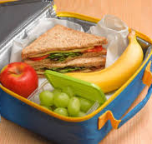
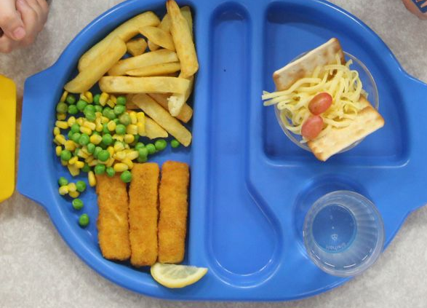

Snack and Lunch Times
Snack is provided.
All children in EYFS are entitled to a free school meal if they wish.
Packed lunches please bear in mind how much you pack.
Use of cutlery.
.

Slide 5
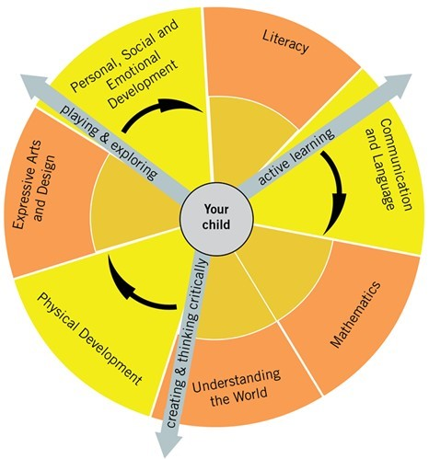
Curriculum
Follow Statutory Framework for Early Years.
The three Prime areas are:
Communication and language.
Physical development.
Personal, social and emotional development.
The four Specific areas are:
Literacy.
Mathematics.
Understanding the world.
Expressive arts and design

Slide 6
Curriculum
Independence and selfcare
Sharing, taking turns and conflict resolution
Phonics
Mark making and handwriting. Correct Grip.
Counting, numeral recognition and problem solving
Shapes, space and measures
Stories, recounts and retelling
Reading
Child initiated learning
Open questioning
Speaking in a group

Slide 7
School Day
From your Child’s viewpoint
I sung Nursery rhymes
I jumped about
I played with the farm
I had snack and story and played outside
I built a tower
I played with playdough
Then it was lunch time and after I ate, I played in the forest area
I worked with Mrs Teeder and just played!
.

Slide 8

Phonics
Essential Letters and Sounds
Learn phonics by means of a picture mnemonic
Blending hands - ‘Sound talk’ ie. C-a-t cat.
Robot arms
Non decodable words, ‘Harder to read and Spell’ words eg. The, said
Includes writing
Class based

Slide 9
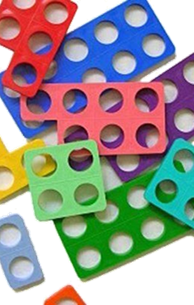


Maths
Follow White Rose Maths Scheme along with the rest of the school
Using concrete practical activities
Crucial to grasp fundamental mathematical principles
Counting with correspondence
Comparative and Positional language
Recognise and recreate sequences
2D/3D shapes

Slide 10

Behaviour
Ready, Respectful and Safe rules.
Home school agreement.
Positive reinforcement.
Notes:
Explain the Houses –

Slide 11
Communication
Weekly email via eSchools – Friday afternoon/evening.
Note in Home school log/Reading record or via Famly.
Oral Reports – must be brief. If complex, please email.
Do email or phone the school rather than worry.
WhatsApp Groups
If any issue occurs, please do not contact the other parent directly, but let us know.

Slide 12
Church School
Collective Worship – class based at first.
Prayers at lunch and home times
Revd. Ainsley Swift once a week.
Open The Book. A biblical story assembly with Mrs Teeder

Slide 13
Housekeeping
Name everything!
PE Day is Friday
Birthdays – Own clothes
Parking code of conduct
Show ‘n’ tell
No toys are allowed in school.
Toileting – Regular reminders
Houses – To be launched!

Slide 14
Housekeeping cont.
If late, please notify office. If emailing use
office@braywoodfirstschool.co.uk
If going home with a friend, you must notify a member of staff or the office.
Please ring the school, as early as possible if your child is unwell.
Attendance
Breakfast Club and After School Club.

Slide 15
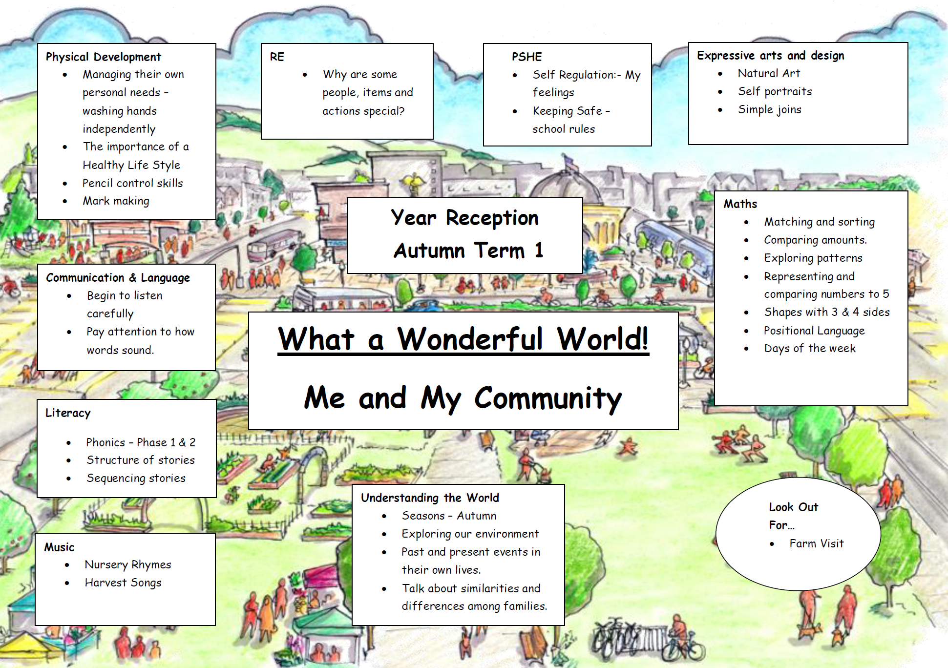

Slide 16

From Little Acorns, Mighty Oak trees grow, watered and nurtured by God’s love .

